Slide 1
3D Segmentation
Todd Fallesen

Slide 2
Quick Overview
Setting up Anaconda
What even is it
Setting up FIJI
Get those plugins installed!
Segmentation Overview
Classical vs Machine Learning
Classical Segmentation Overview
Dynamic Range
Watershed
Machine Learning Segmentation Overview
What we use it for
FIJI and trackmate
Set up FIJI with Trackmate/StarDist/Cellpose
Use 3D Objects counter in FIJI
Cellpose and stardist
Use a jupyter notebook to open and predict on files
2
Notes:
Please feel free to ask questions

Slide 3

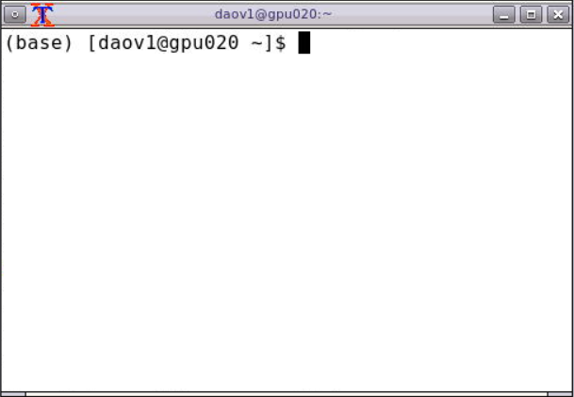
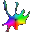



Anaconda
Initialising Anaconda
cellpose-environment
Package and environment management software
Conda environments are a method for creating an isolated space with different software and their dependencies installed.
Conda environments can also help with reproducibility.
Python 3.9
conda create --name testenv python=3.8
conda env list
conda activate testenv
pip install numpy
conda deactivate
conda env remove --name testenv
cellprofiler-environment
Python 3.8
stardist-environment
Don’t install anything in your base environment!
Always activate your environment before installing packages!
Python 3.10
Notes:
So many different packages out there to do great things, they do not work together – that’s why Anaconda

Slide 4
Create and remove a conda environment
Conda environments are complete package environments
Can be imported, exported, created from files or manually
Create a manual conda env
conda create –-name testenv python=3.8
conda activate testenv
pip install numpy
conda deactivate
conda env remove --name testenv

Slide 5
Create a conda environment from a file
name: Crick_IA
channels:
- conda-forge
dependencies:
- python=3.9
- numpy
- scikit-image
- pandas
- seaborn
- matplotlib
- stardist
- cellpose
- ipython
- ipykernel
- jupyterlab
#- remote_ikernel
#need to pip install remote_ikernel after activating
Conda environments are Portable and reproducible.
Creating an environment from a file is an easy way to make sure that someone else is using the same environment as you are.
You can export environments as well to send.

Slide 6
Jupyter notebooks
Navigate to where you want to save your notebook first! It’s easier
cd -- change directory
cd .. Move up a directory
cd – just go home
ls or dir – get list of directories (mac/pc respectively)

Slide 7
Set up our Anaconda Environment for Image Analysis
Please follow the directions at:
https://tinyurl.com/yackwp9s
https://github.com/FrancisCrickInstitute/multi-dimensional-imaging-and-analysis/blob/main/3D_Segmentation/readme.md
Download course files

Slide 8
Fiji Setup

Slide 9
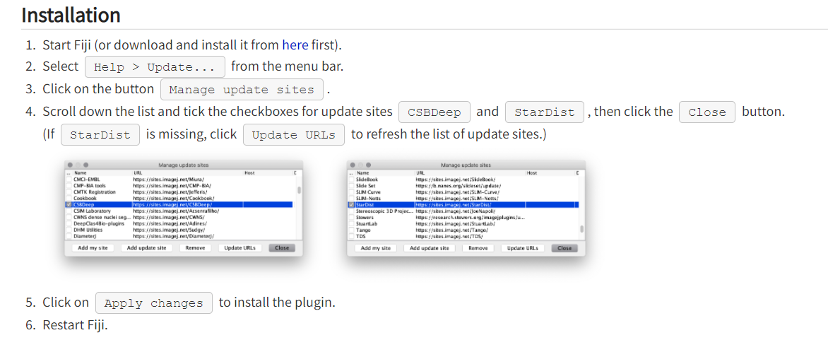
To Install Stardist in FIJI
Notes:
https://imagej.net/plugins/stardist

Slide 10
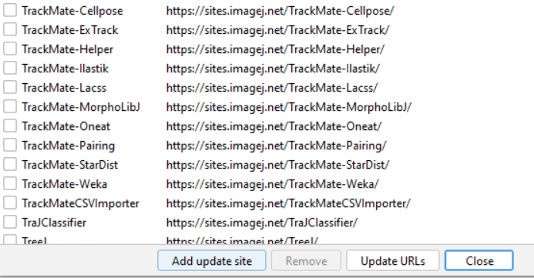
Trackmate-3D
Please install the following plugins as well
3D ImageJ Suite

Slide 11
Segmentation Methods
Classical Segmentation
Thresholding
Watershed
Morphological Operations
Machine Learning
CellPose
StarDist
WEKA/Ilastik
Regardless of method:
Cropping!

Slide 12
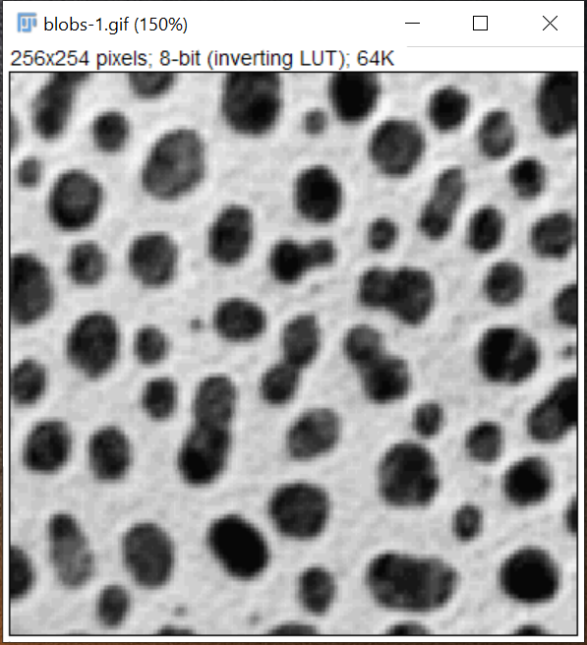
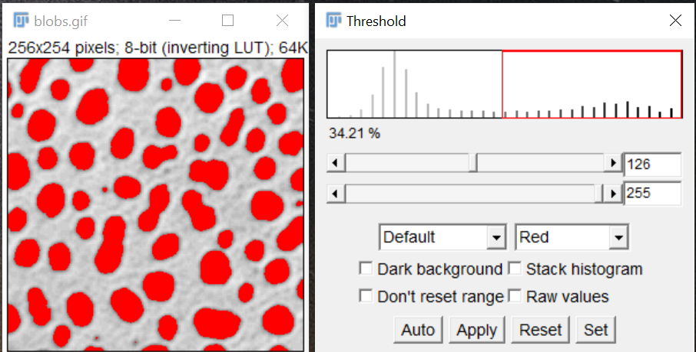
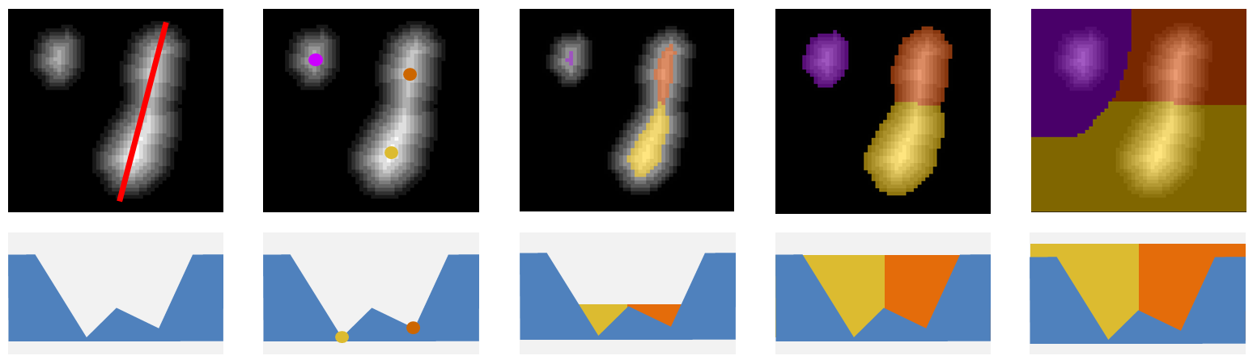
Thresholding and Watershed
https://imagej.net/imagej-wiki-static/Interactive_Watershed

Slide 13

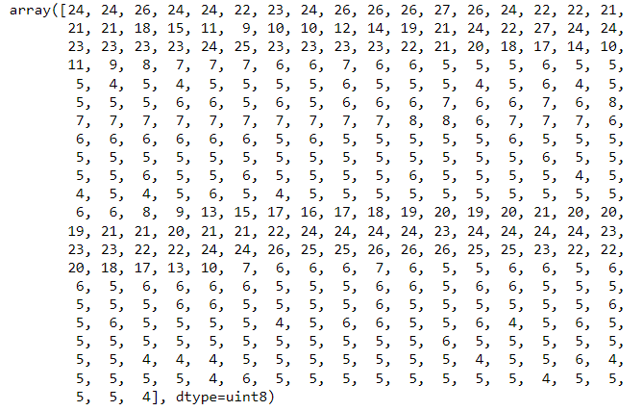
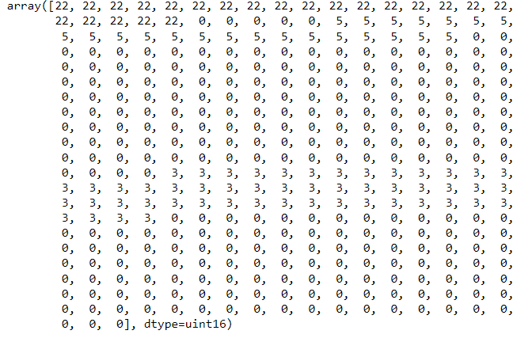
Dynamic Range

Slide 14
Machine Learning Segmentation Pixel Based
Ilastik or FIJI Weka used pixel based segmentations
These we train by painting the objects of interest, and training the segmentation
Pros:
Quick to train
Easy to understand
Easy to use
Cons:
Not as specific
Not as broadly applicable once trained

Slide 15
Machine Learning Segmentation Object Based
Object based segmentations like CellPose and StarDist segment cells, nuclei, etc
Models are pre-trained, and very quick to use if your data fits the training data
Pros:
Can be quite accurate
Very quick
Cons:
Everyone wants to use them
Can be hard to implement
Difficult to train new models

Slide 16
2D Example
Open up Blobs (Cntrl+Shift+B)
Run a threshold on it (Cntrl+Shift+T)
Run analyze particles

Slide 17
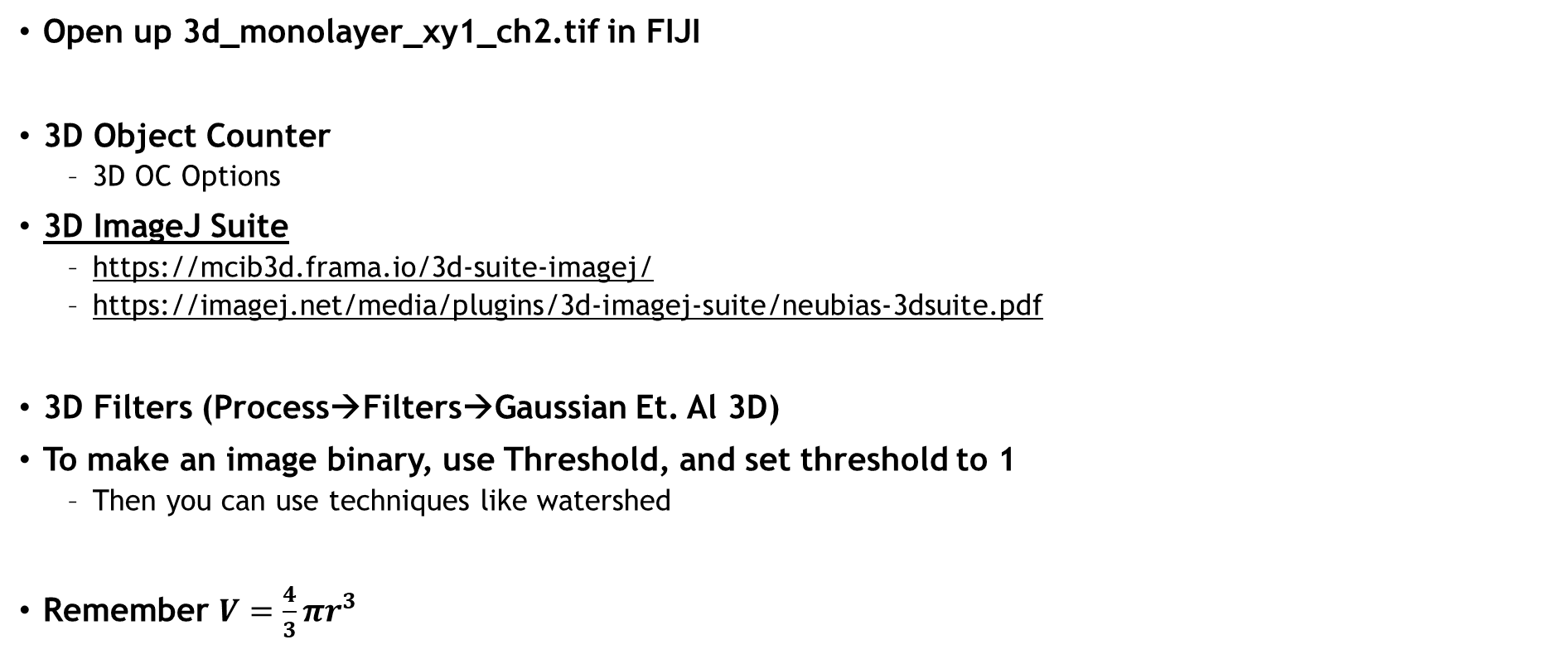
3D Classical Segmentation
Open up 3d_monolayer_xy1_ch2.tif in FIJI
3D Object Counter
3D OC Options
3D ImageJ Suite
https://mcib3d.frama.io/3d-suite-imagej/
https://imagej.net/media/plugins/3d-imagej-suite/neubias-3dsuite.pdf
3D Filters (Process→Filters→Gaussian Et. Al 3D)
To make an image binary, use Threshold, and set threshold to 1
Then you can use techniques like watershed
Remember $V=\frac{4}{3}πr^{3}$

Slide 18
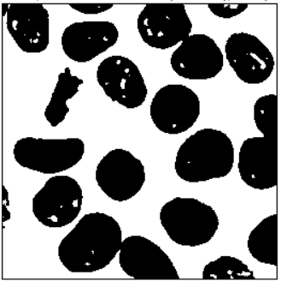
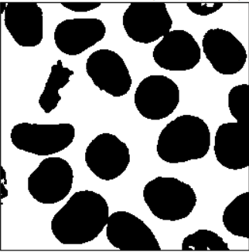
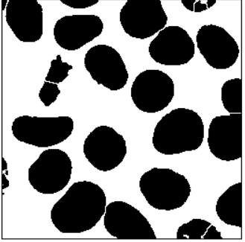
Morphological Operations
Morphological operations are done on binary objects
Erode, Dialate, Close, Open, Fill Holes (Process→Binary→Options)
You can use 3D object counter then to visualize the different objects
Mask
Fill holes
Watershed

Slide 19
Viewing results
Use the FIJI → Image → Color to merge or split channels to visualize in 2D
You can use 3D Image Viewer to view in 3D, but you will probably have to do thresholding first.

Slide 20
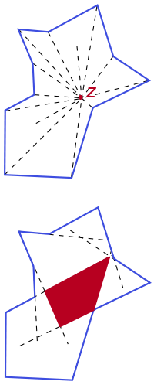
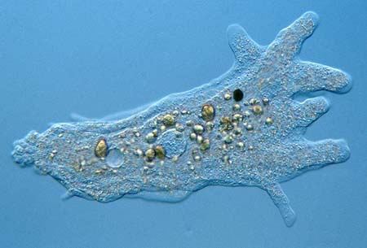
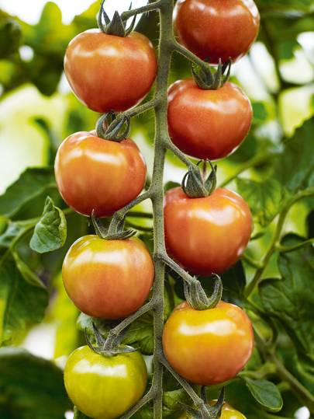
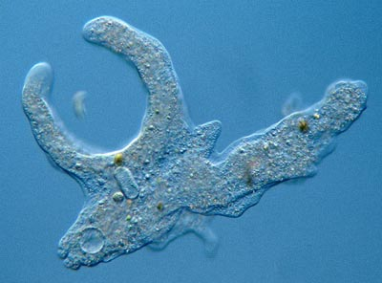
Star-convex?
Stardist can only detect objects that are Star-convex: all the points of the perimeter can be reached by rays emanating from a point somewhere in the object.

Slide 21
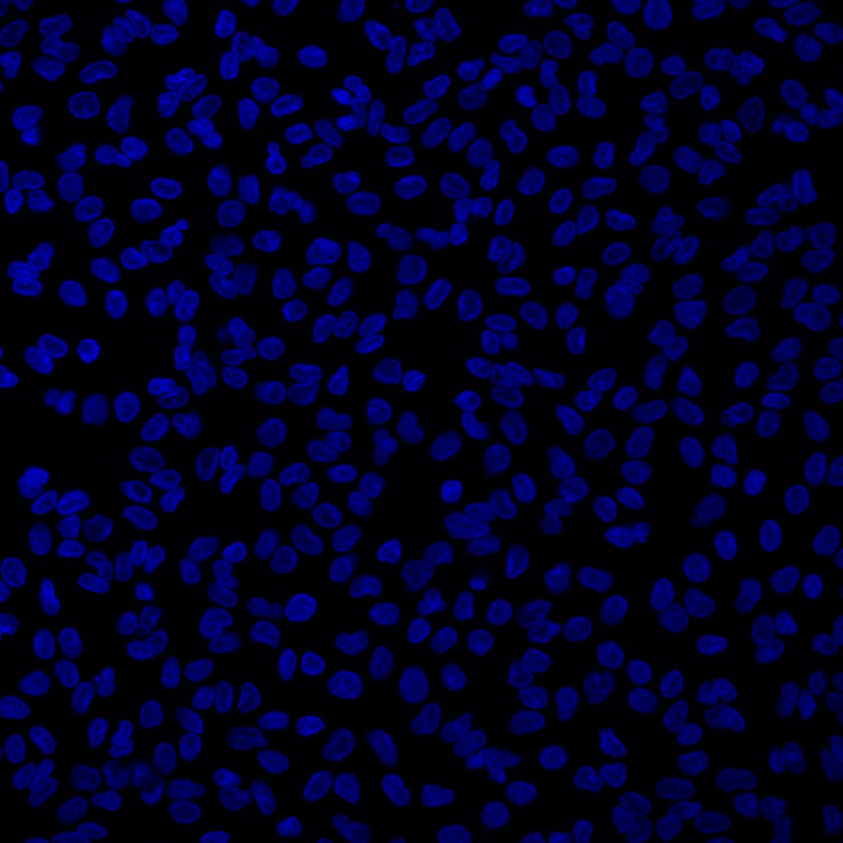
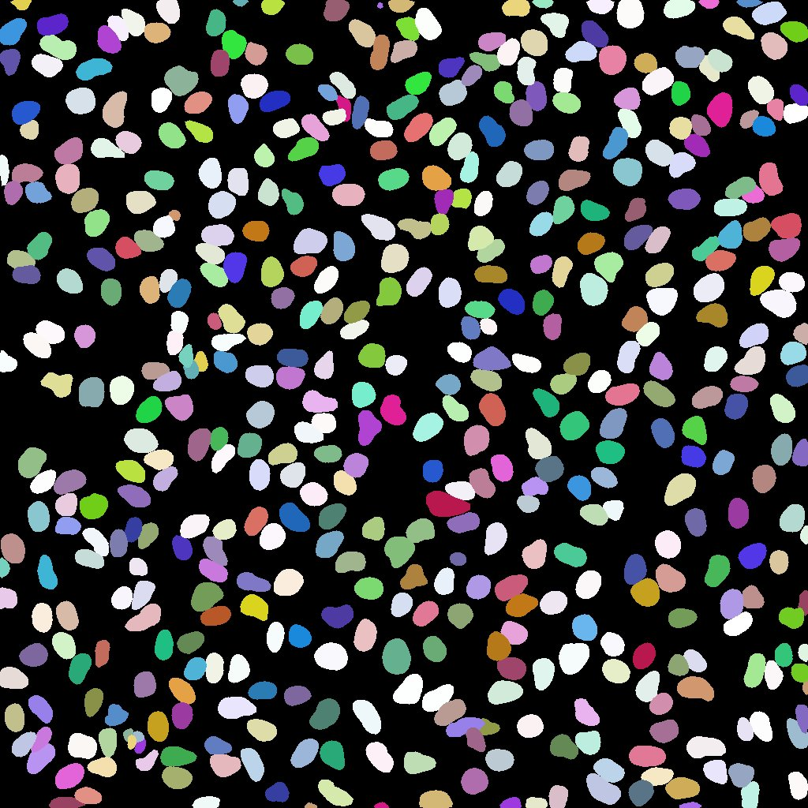
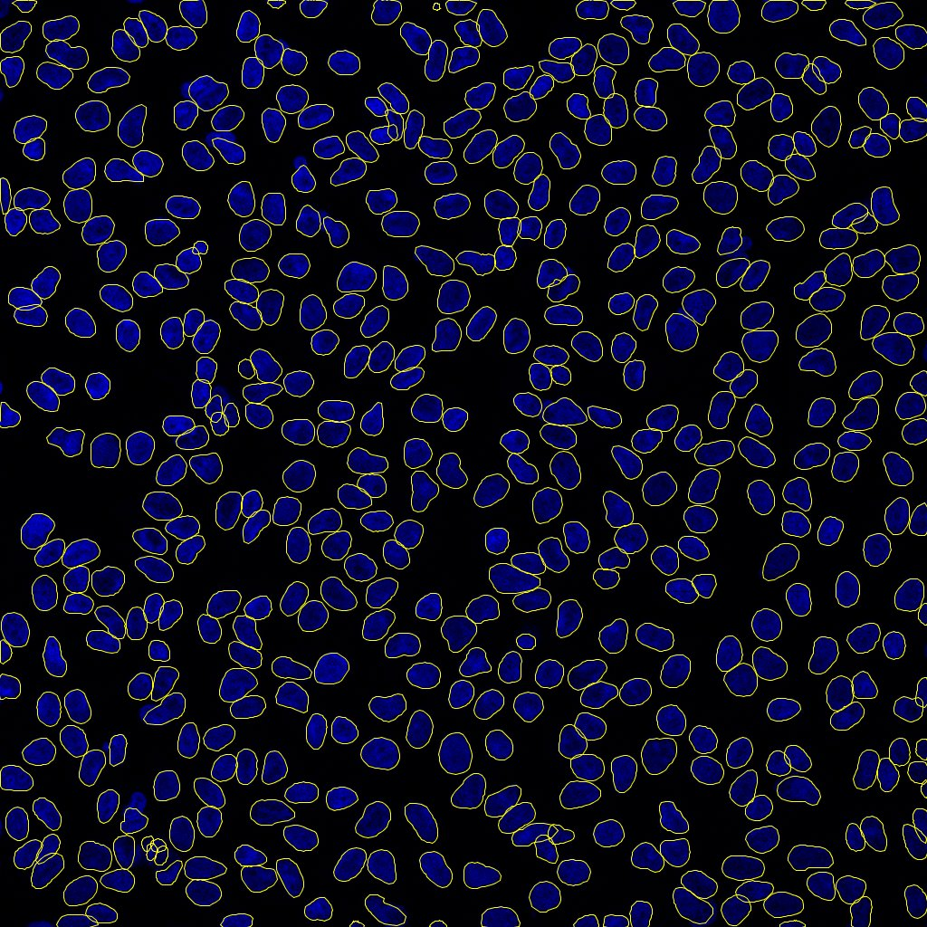
Quick-use FIJI
https://imagej.net/plugins/stardist

Slide 22
FIJI Demo
Open up FIJI, install StarDist
Open the file: Image_Set_001.tif
Run Stardist on this image (plugins → StarDist→Run)

Slide 23
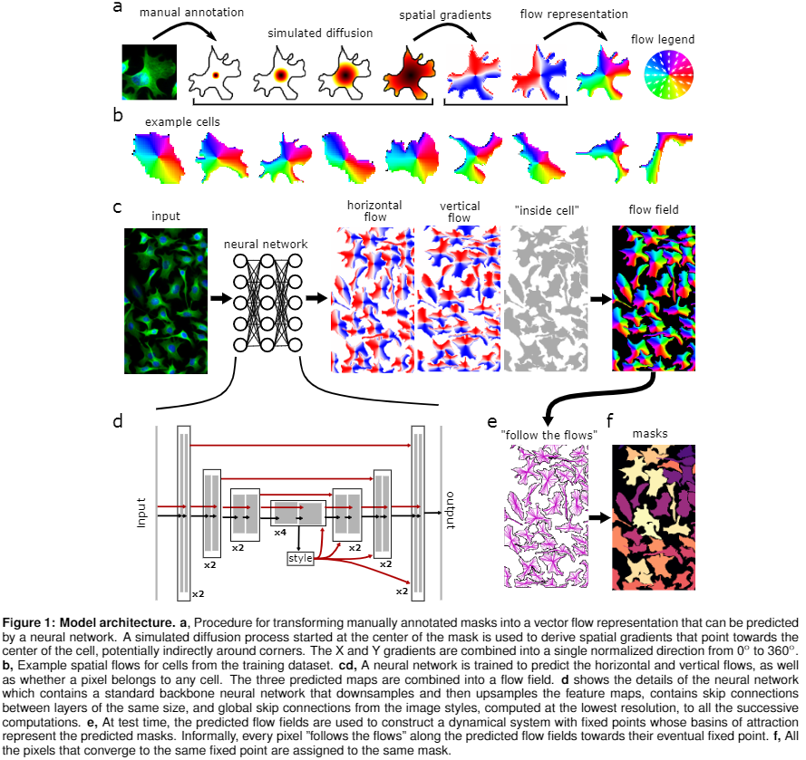
Cellpose
Cellpose is a segmentation algorithm similar to stardist, but it can segment objects that have varying shapes.
Was trained on a bunch of different objects, not just nuclei.
Can be used natively, in python, in 3D

Slide 24
3D Segmentation using Trackmate
We can trick Trackmate into “tracking” in Z, integrating our Z-slices into a 3D object
Load a 3D Image (Try 3D_monolayer_xy1_ch2.tif)
Launch FIJI→Plugins→Tracking→Trackmate
If asked to swap Z and T, say yes!
Select “StarDist Detector”
Click Preview: See how it looks
Set spot filters to clean up your segmentation
Select Simple Lap Tracker or Overlap Tracker
For Simple Lap, I use Max distances=1um gap-closing=1 frame
Select filters on Tracks
May want to filter on distance or number of spots
Click through to the end, then Export Label Image
Select “Export only spots in tracks” and execute

Slide 25
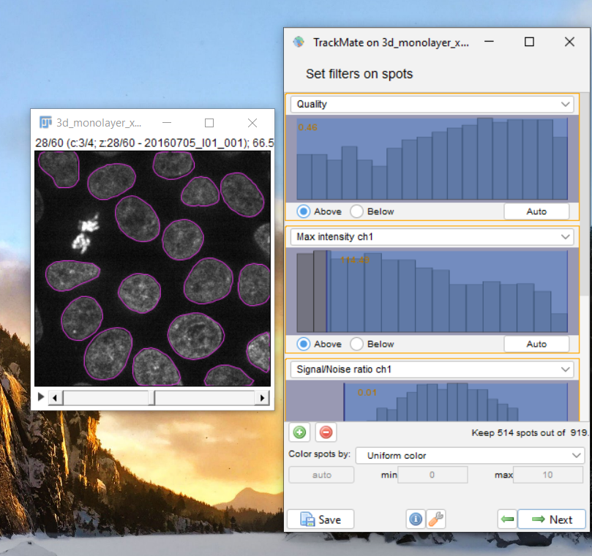
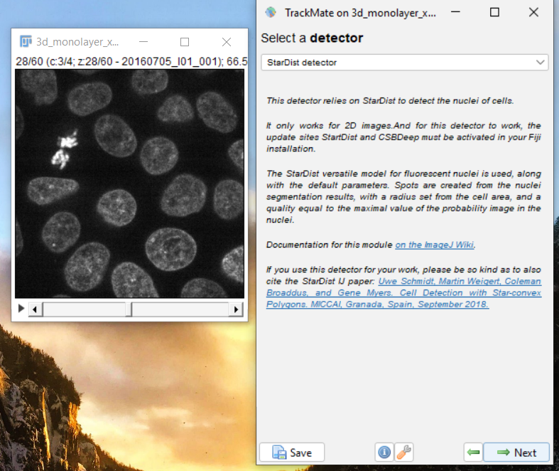
StarDist

Slide 26
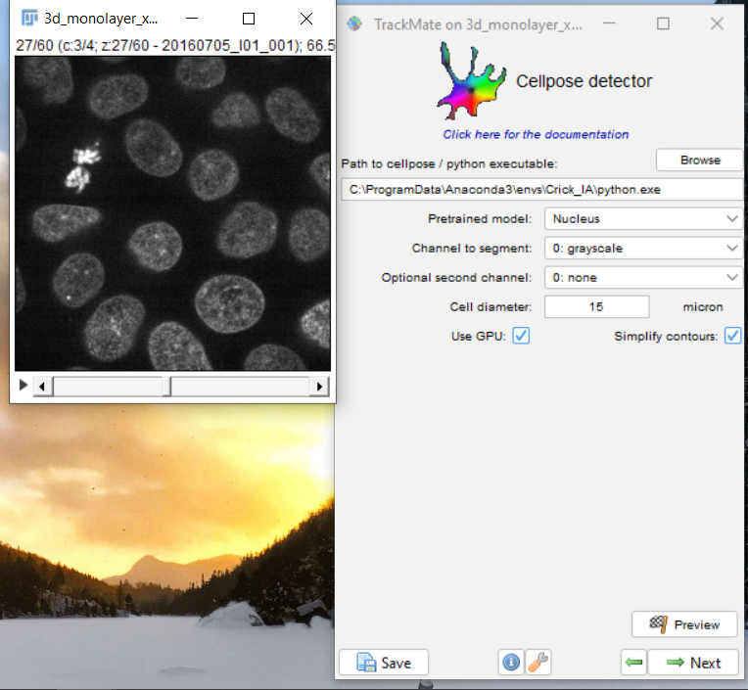
Setting up CellPose on Trackmate
You need to point your trackmate installation at your cellpose python installation (in this case, Crick_IA)
Be sure to enter the diameter in the units that it asks for
Click Preview to check the detection
Detection takes a lot longer than StarDist
(Took about 5 minutes on my Laptop)

Slide 27
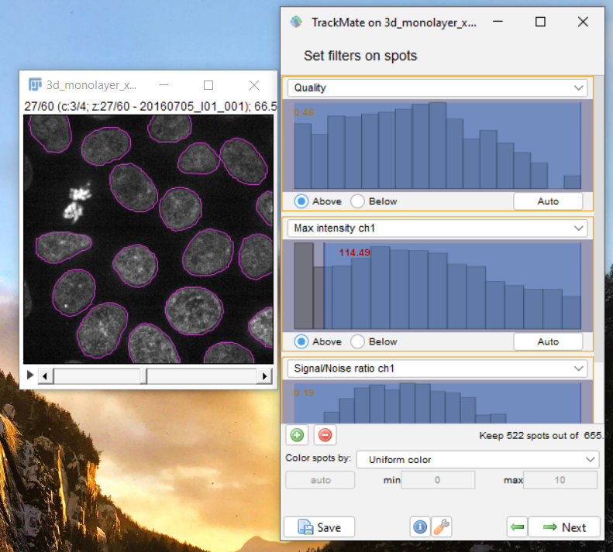
CellPose

Slide 28
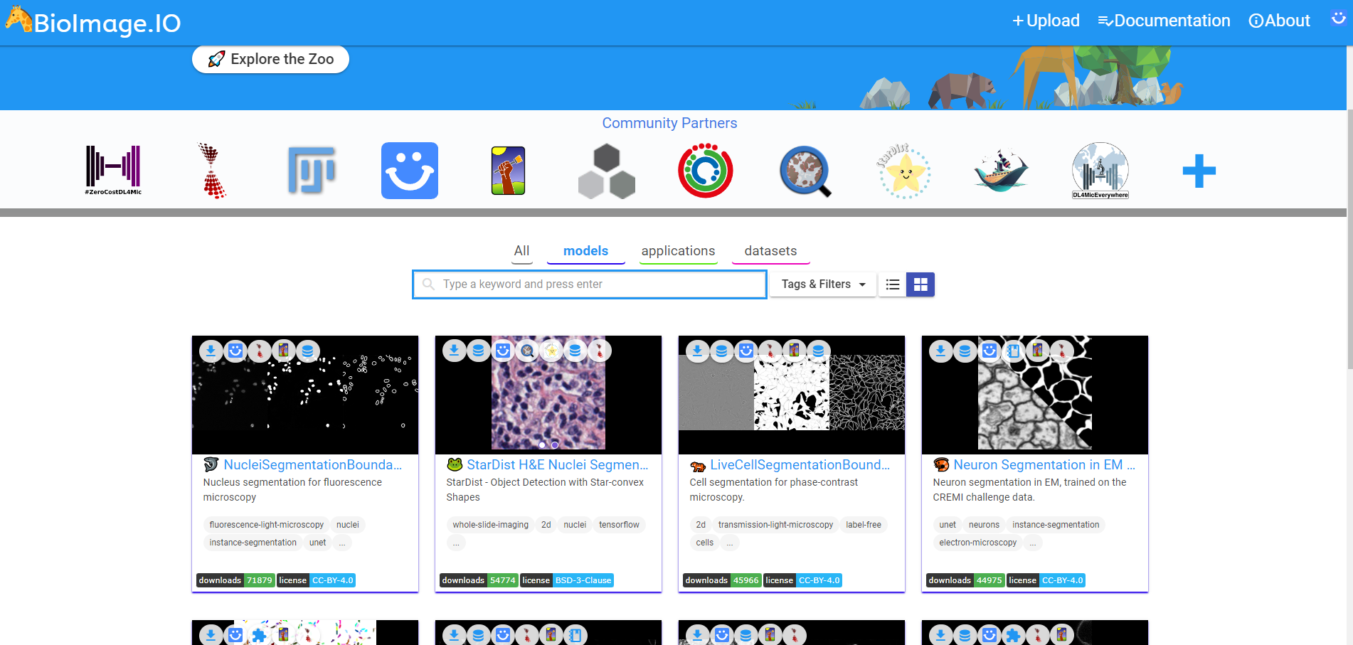
BioImage Model Zoo
https://bioimage.io

